Slide 1
Heart disease diagnostic Analysis
By,
Kalaivani Lakshmanan

Slide 2
Objective
The objective of Heart Disease Diagnostic Project is to check whether the patient is likely to be diagnosed with any cardiovascular heart diseases based on their medical attributes such as gender, age, chest pain, fasting sugar level, serum cholesterol, etc.

Slide 3
Problem statement
Health is real wealth in the pandemic time we all realized the brute effects of covid-19 on all irrespective of any status. Hence it is required to analyze this health and medical data for better future preparation.
The correct prediction of heart disease can prevent life threats, and incorrect prediction can prove to be fatal at the same time.
The dataset consists of 14 main attributes used for performing the analysis.

Slide 4
Attribute Information
Age: displays the age of the individual.
Sex: displays the gender of the individual using the following format : 1 = male 0 = female
Chest-pain type: displays the type of chest-pain experienced by the individual using the following format : 0 = typical angina 1 = atypical angina 2 = non — anginal pain 3 = asymptotic
Resting Blood Pressure: displays the resting blood pressure value of an individual in mmHg (unit)

Slide 5
Serum Cholestrol: displays the serum cholesterol in mg/dl (unit)
Fasting Blood Sugar: compares the fasting blood sugar value of an individual with 120mg/dl. If fasting blood sugar > 120mg/dl then : 1 (true) else : 0 (false)
Resting ECG : displays resting electrocardiographic results 0 = normal 1 = having ST-T wave abnormality 2 = left ventricular hyperthrophy
Max heart rate achieved : displays the max heart rate achieved by an individual.
Exercise induced angina : 1 = yes 0 = no

Slide 6
ST depression induced by exercise relative to rest: displays the value which is an integer or float.
Peak exercise ST segment : 0 = upsloping 1 = flat 2 = downsloping
Number of major vessels (0–3) colored by flourosopy : displays the value as integer or float.
Thal : displays the thalassemia : 0 = no, 1 = normal 2 = fixed defect 3 = reversible defect
Diagnosis of heart disease : Displays whether the individual is suffering from heart disease or not : 0 = absence 1 = present.

Slide 7
Approach
Used Python for Data Analysis.
Used Tableau for Data Visualization.

Slide 8
Quick Insights From Cleaned dataset
Total Patients Count – 302
Male Patients – 206, Female Patients – 96
Total Heart Disease diagnosed Count – 164
Heart Disease diagnosed Rate – 54.3%
Gender Count of Heart Disease diagnosed Patients: Male – 92, Female – 72

Slide 9
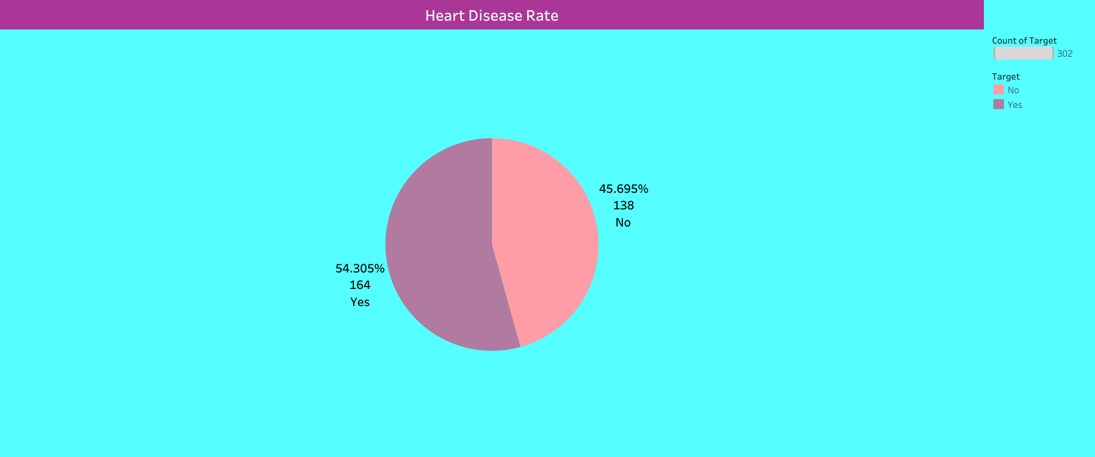

Slide 10
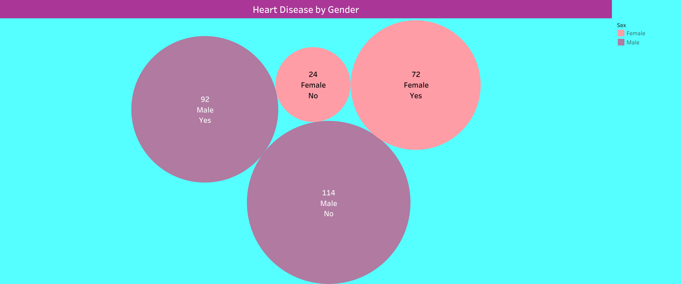

Slide 11
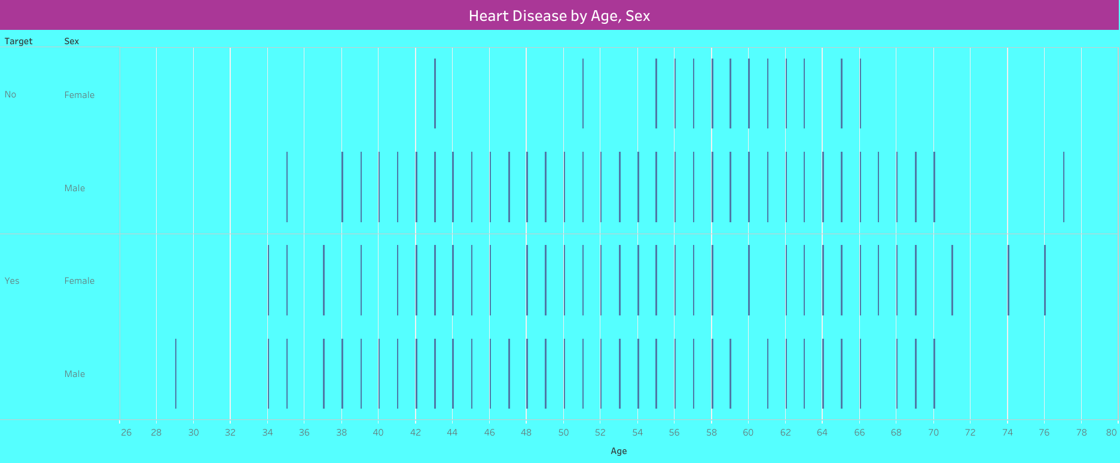

Slide 12
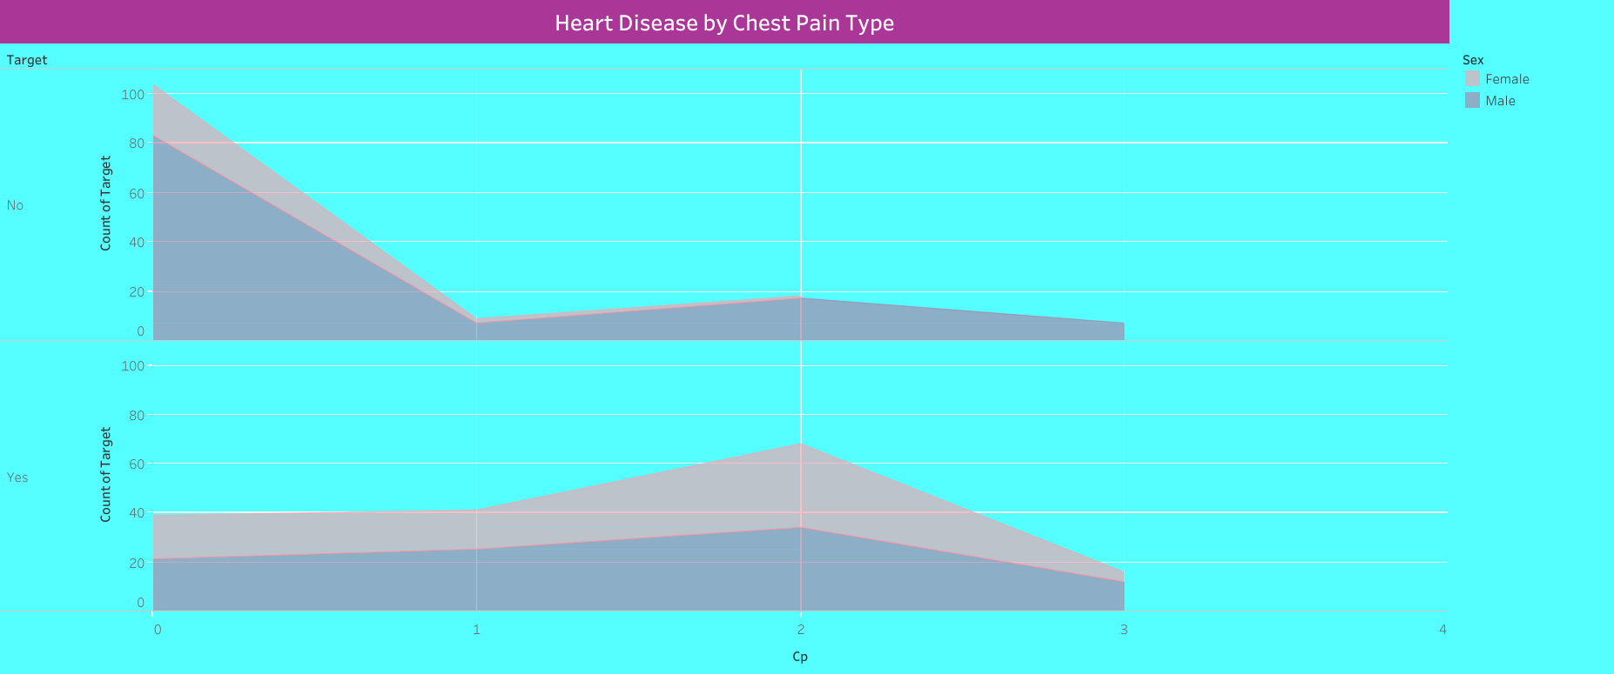

Slide 13
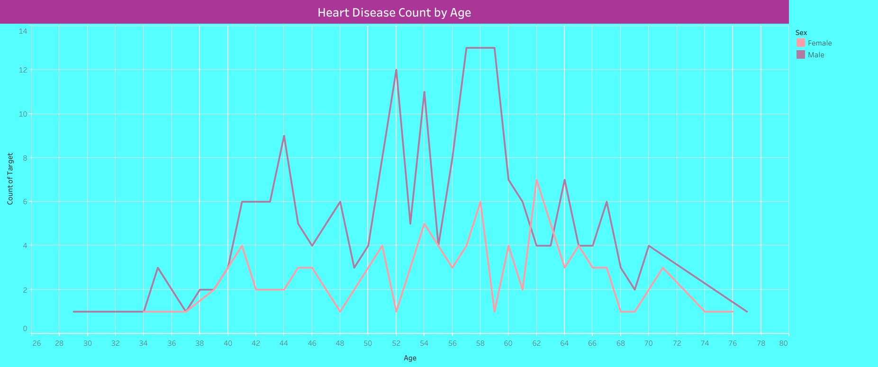

Slide 14
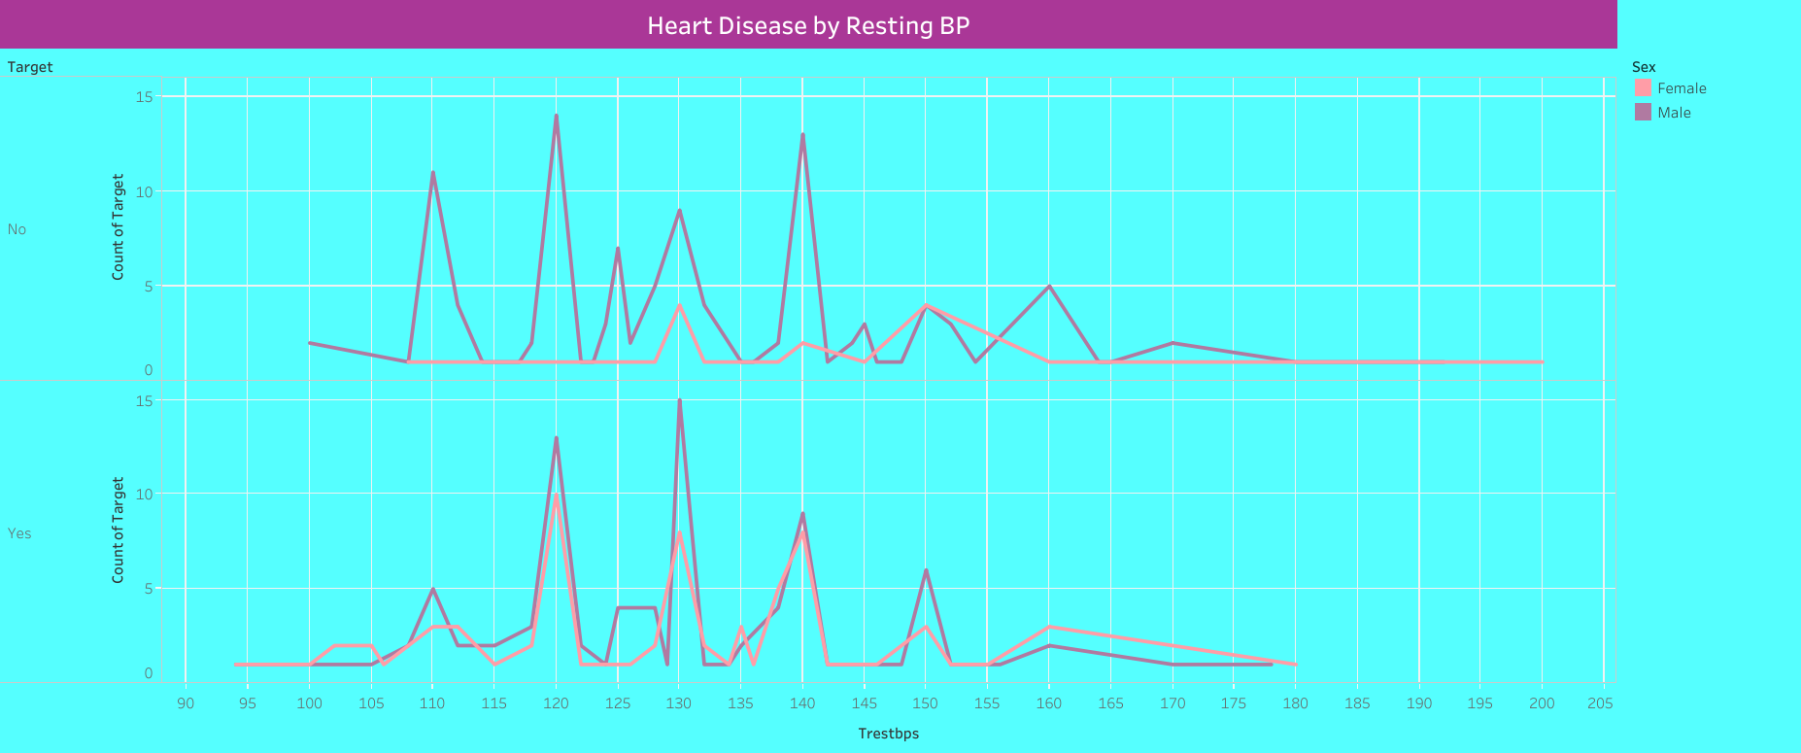

Slide 15
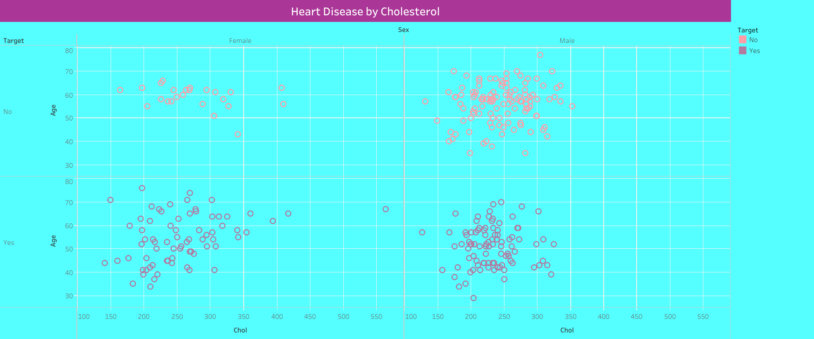

Slide 16
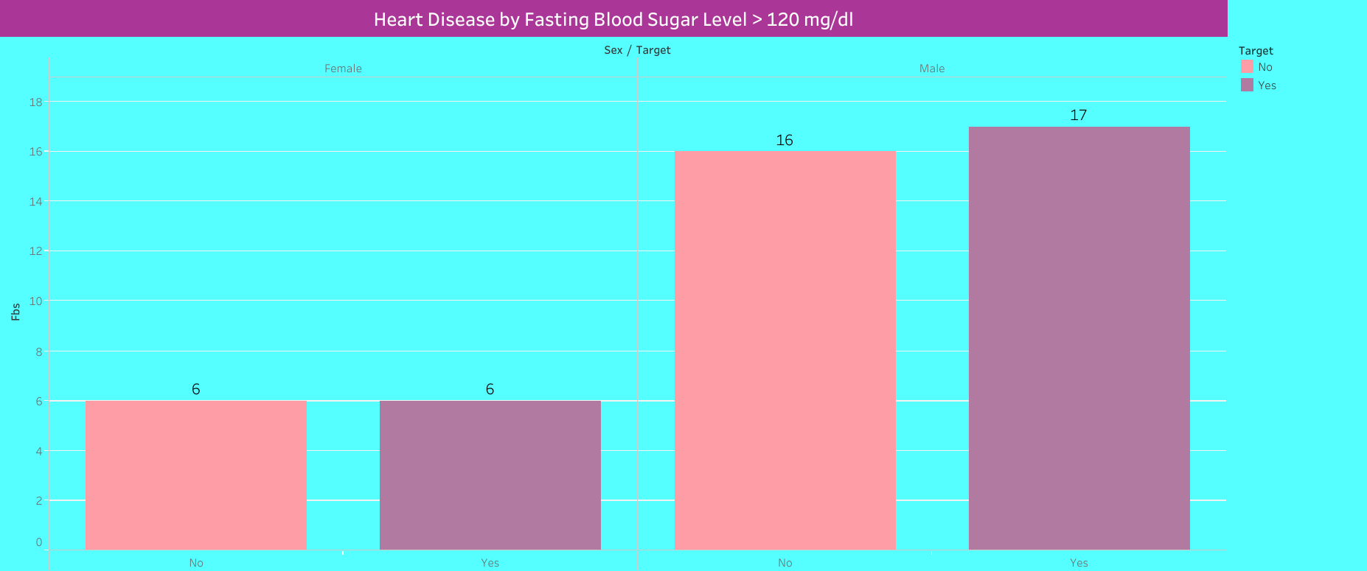

Slide 17
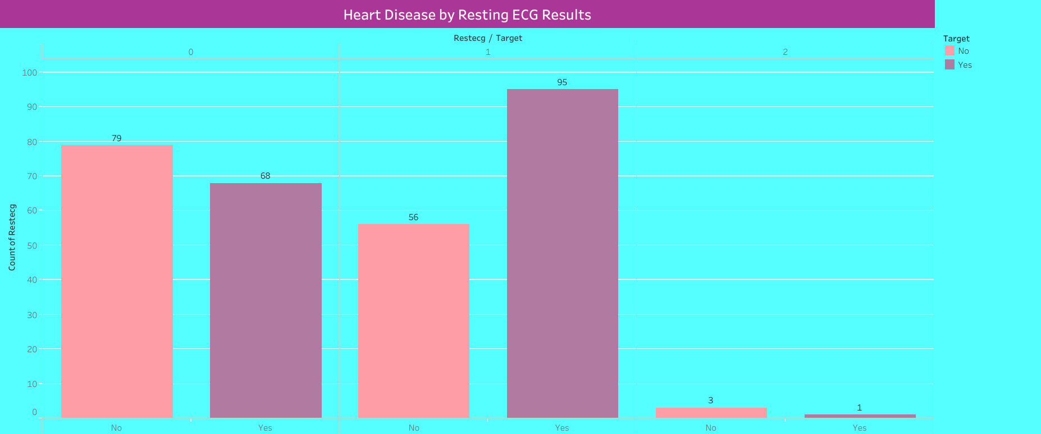

Slide 18
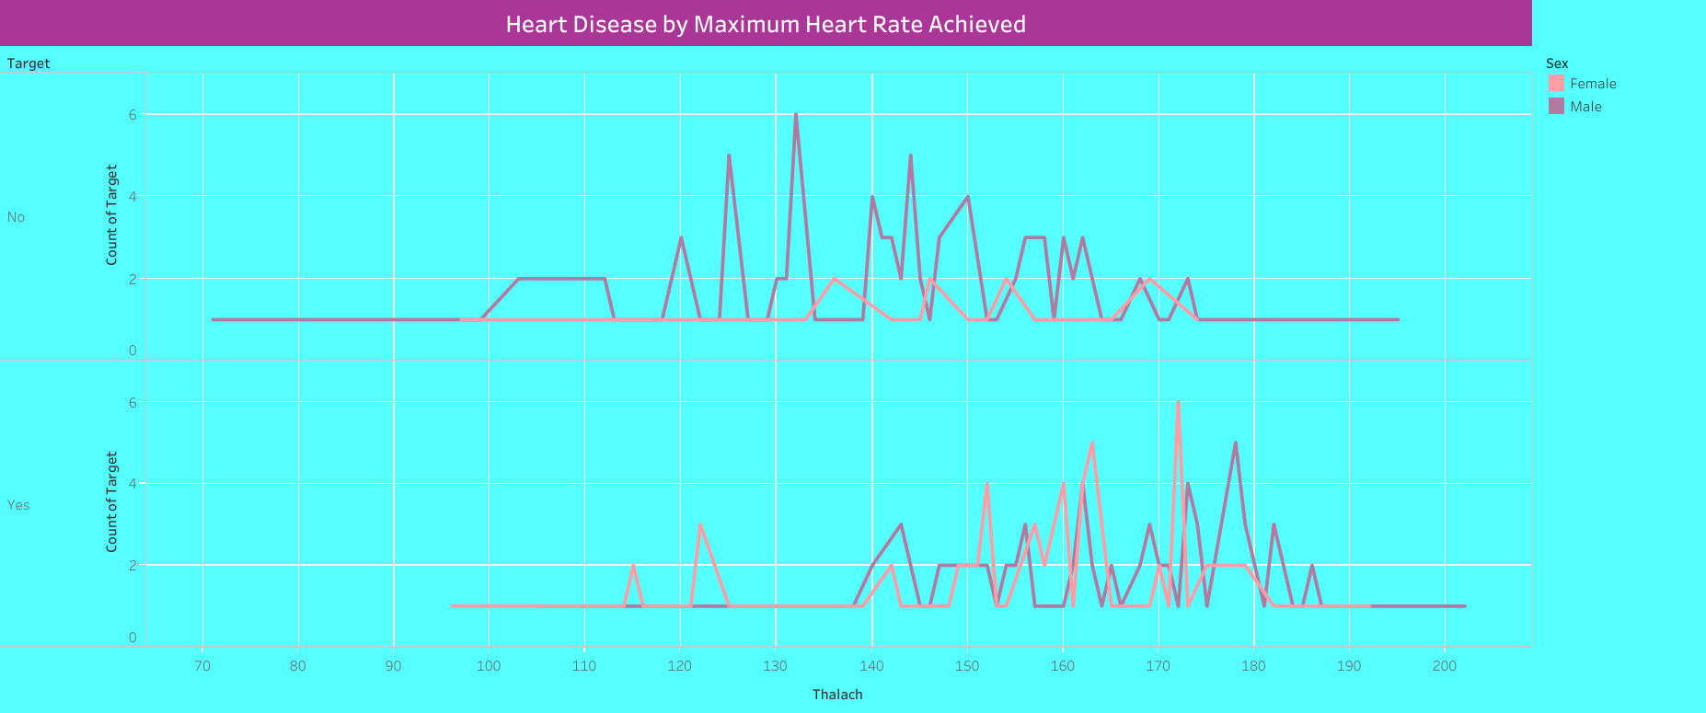

Slide 19
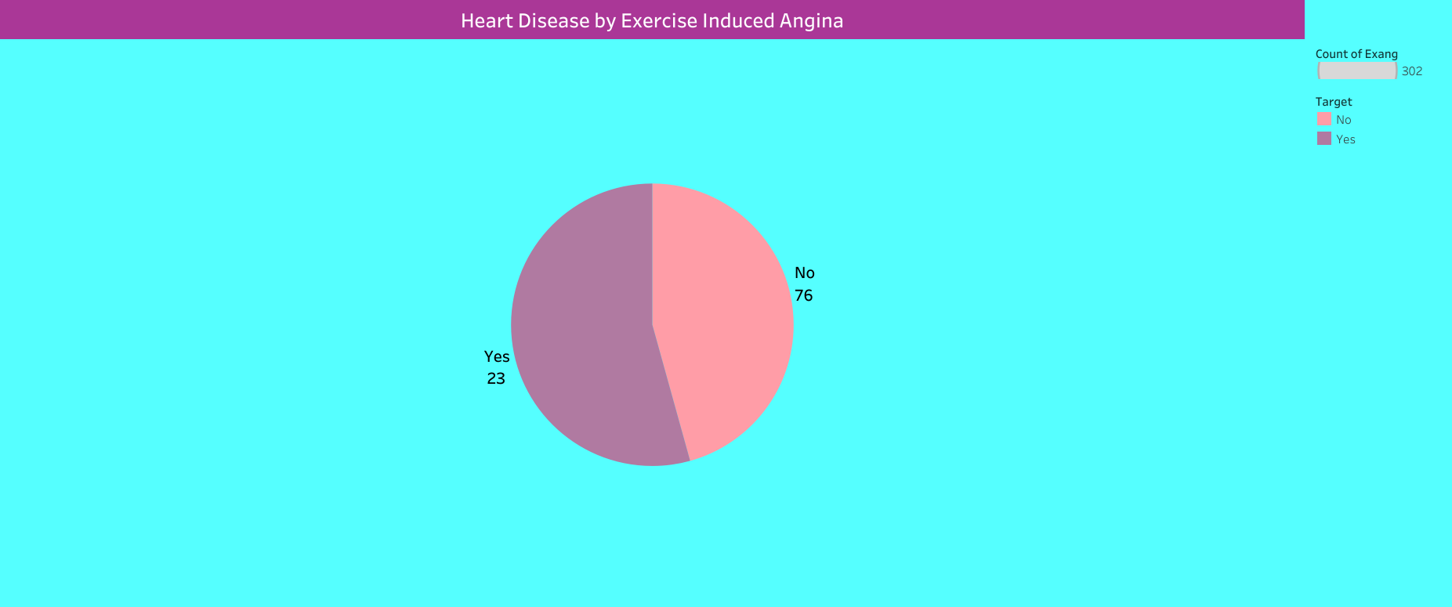

Slide 20
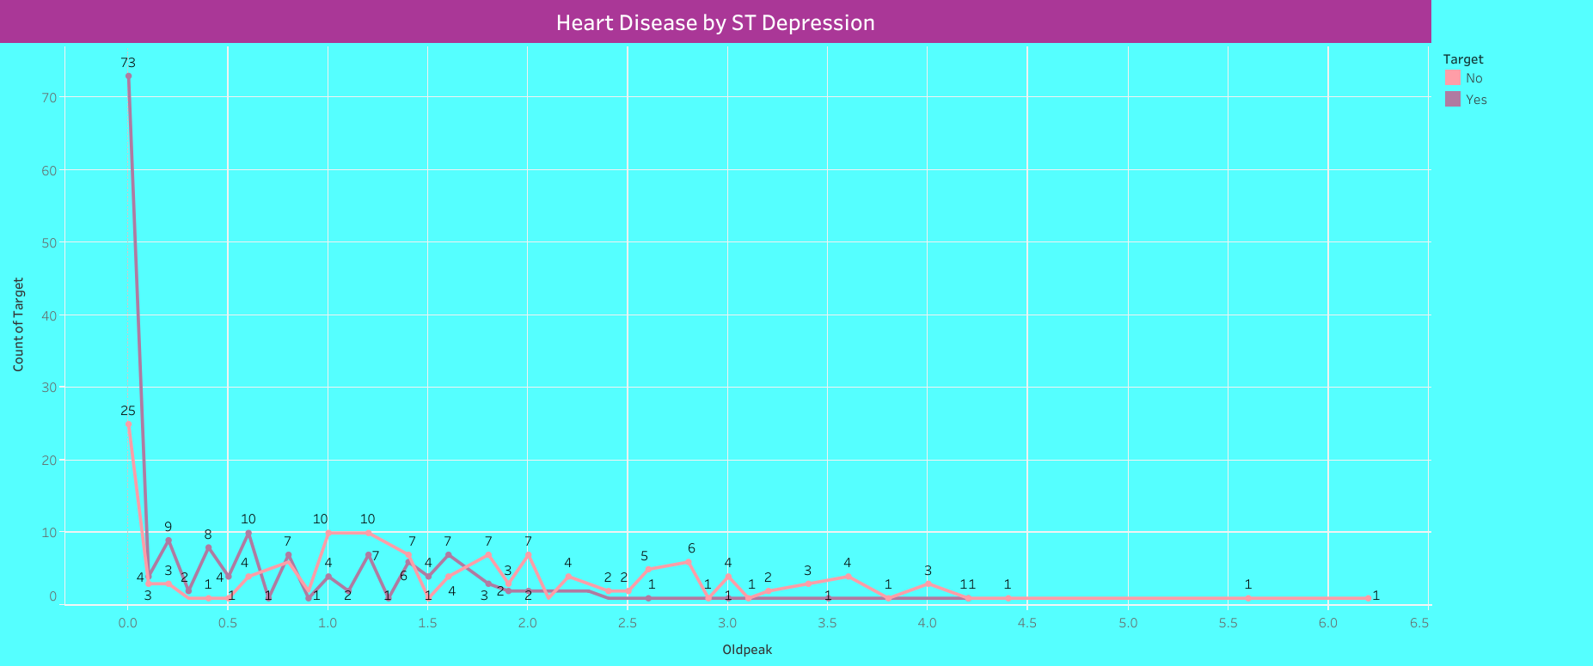

Slide 21
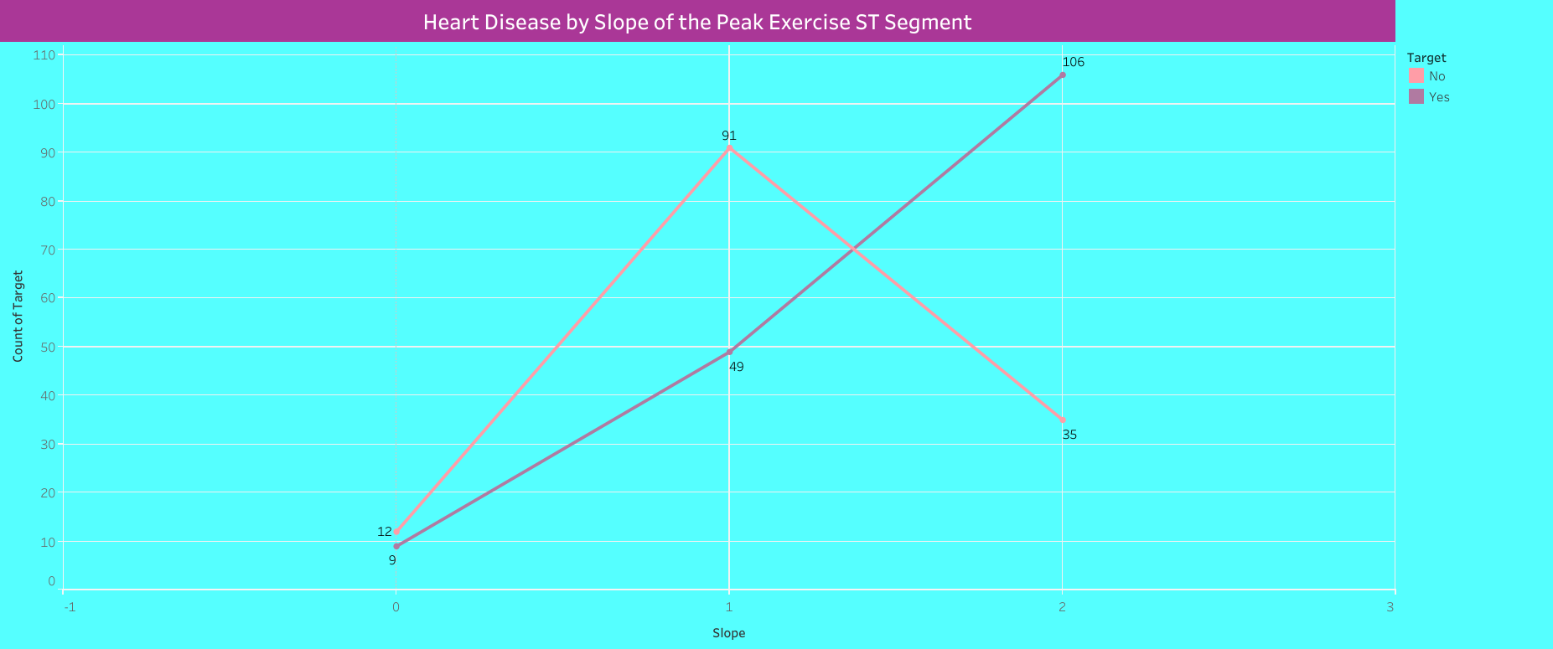

Slide 22
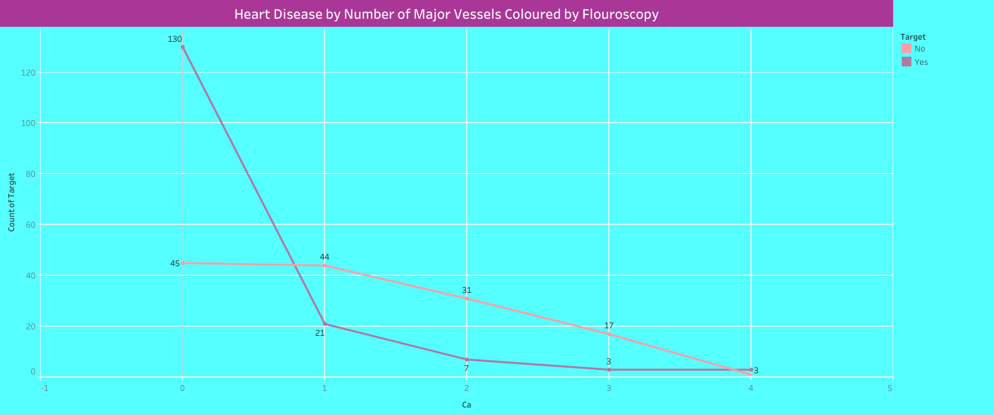

Slide 23
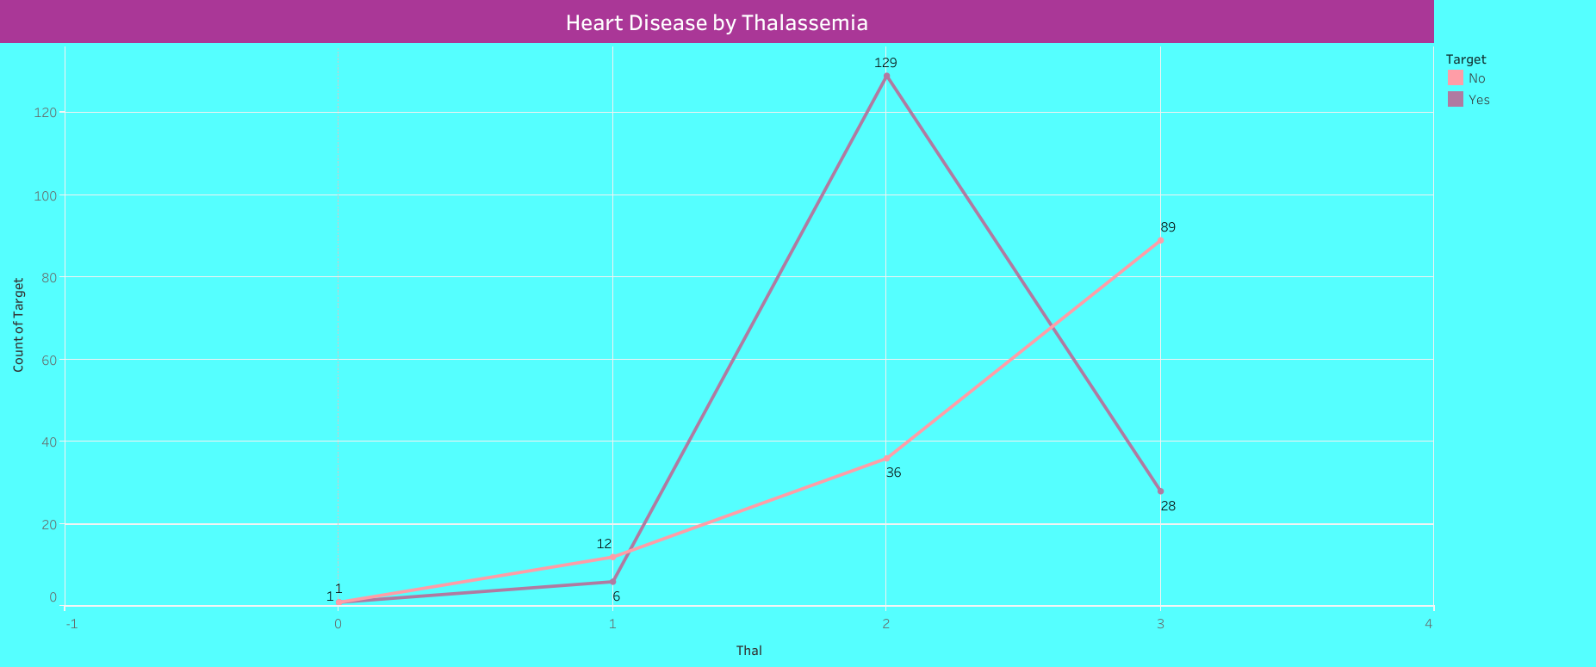

Slide 24
Key Findings
Male patients are suffering from heart disease at an earlier age of 29 than female patients.
Heart disease patients are more for the age group 50 to 70 and their count is high in the age of 57,58,59 for male, 62 for female.
Heart disease diagnosed patients count is more for the Non-anginal Chest Pain type patients.
Heart disease patients are more with resting blood pressure 120 – 140 mmHg .
Heart disease patients are more with serum cholesterol level > 120 mg/dl.
No significant difference between healthy and heart disease patients in fasting blood sugar level > 120 mg/dl.
Heart disease patients are more who have ST-T wave abnormality in resting ECG result.

Slide 25
Heart disease patients count is more who has achieved maximum heart rate > 140 beats per minute.
Number of heart disease patients by exercise induced angina is less compared to healthy patients.
Highest heart disease count with ST depression induced by exercise relative to rest value 0.0000.
Heart disease patients are more who have downsloping peak exercise ST segment .
Heart disease patients count is more with zero number of major vessels coloured by fluoroscopy.
Most of the heart disease patients are detected with fixed defect of thalassemia.

Slide 26
Thank you

